Slide 1

Embedded ECG Heart Monitor
By: Mohamed A. Abdel Hamed
Supervised by: Dr. Shalan
GitHub Repo: https://github.com/Oschart/Embedded-Heart-Monitor

Slide 2
01
02
OUTLINE
Overview
Features & User Guide
03
04
05
Demo Runs
Design & Implementation
Future Development
What is this project about?
System functionalities
06
References
How was the system realized?
Examples of the system in action
What can be improved?

Slide 3
01
Overview
What is this project about?

Slide 4
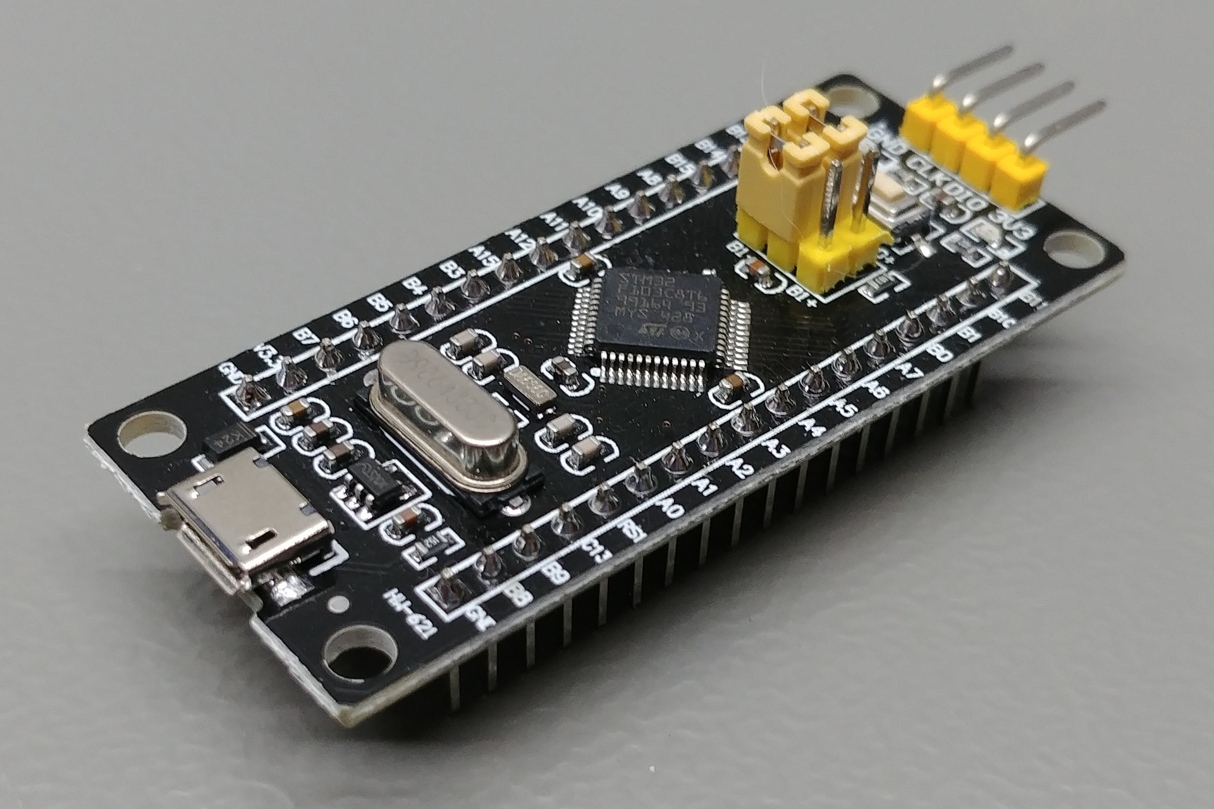
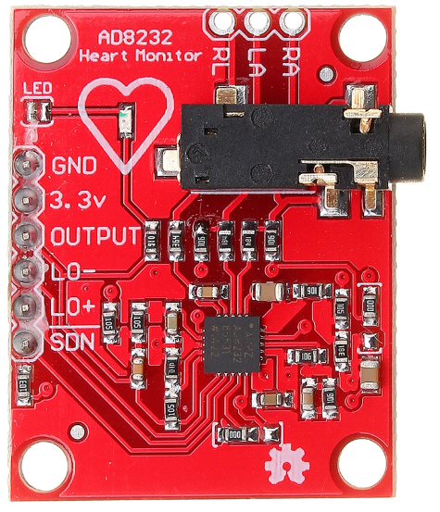
OVERVIEW
Description: Real-time ECG Heart Monitor
System consists of two parts/sides:
Embedded system on an STM32 chip
Desktop application
Hardware used:
STM32F1 Black Pill microcontroller
AD8232 ECG Sensor

Slide 5



OVERVIEW (cont.)
Programming languages used:
Black Pill app: developed in C
PC app: developed using Python 3.8.2
Development software used:
Black Pill app: Keil uVision IDE + CubeMX
PC app: pySerial + matplotlib

Slide 6
02
Features & User Guide
System functionalities and how to use them

Slide 7
Features
Sampling Rate Control
ECG Data Plotting & HR Calculation
Baud Rate Control & Port Selection
Heart beat ECG data is sampled and plotted in real-time
User can control the ECG sampling rate
(1 – 1000 SPS)
Initially, the user can select which port to bind to, and with what baud rate

Slide 8
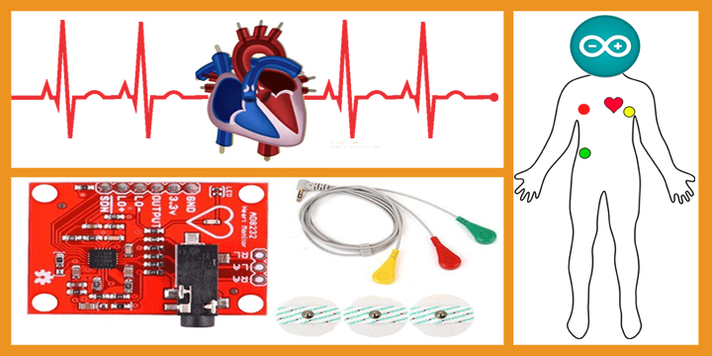
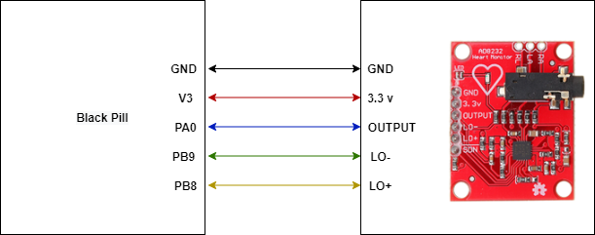
User Guide
This guide assumes the user has the hardware described before (along with a means to download the hex code to the uC) in addition to the required software (including the Python packages).
Below are the steps to use the system:
Make sure all connections are as shown below.
Download the hex code to the Black Pill uC (e.g. though serial programming)
Put the uC into operation mode (if you’re using SP) and click the Reset button.
Go to the “main_app” directory and run the following command “python main.py”
You will be prompted for commands by the double arrow >>

Slide 9
User Guide (cont.)
User Commands:
SSR X | Set Sample Rate to X samples per second (1 – 1000)
C1MWD | Collect 1 Minute Worth of Data: starts data collection and plotting mode for 1 minute, during which the user cannot insert any new commands
RHBR | Report Heart Beat Rate
EXIT | Terminates the app

Slide 10
03
Implementation
How was the system realized?

Slide 11
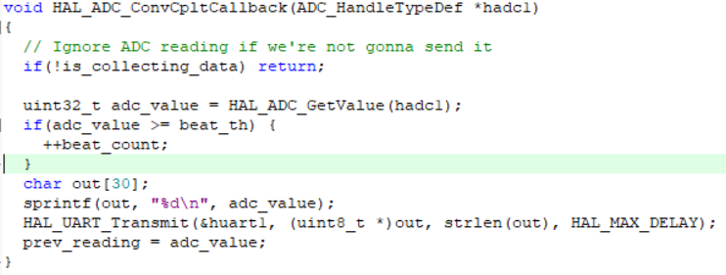
Implementation
1. Sensor Output Sampling:
Done using the Black Pill internal ADC1 (IN0)
Sampling triggering is controlled by the GPTM TIM2 in interrupt mode
Sample size = 12 bits
Heart beat counting and transmission of readings is done in the ADC ISR callback.

Slide 12
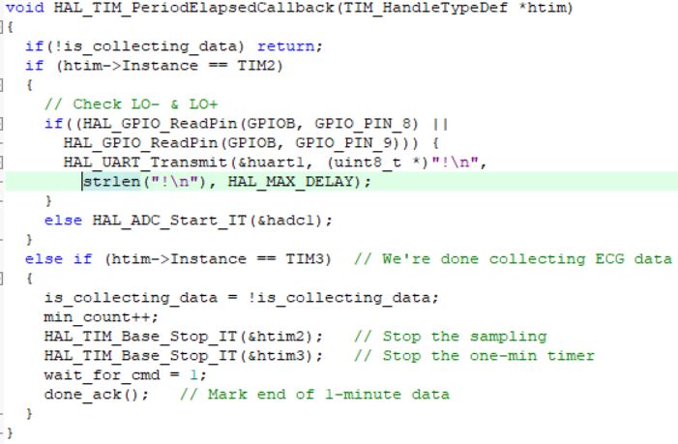
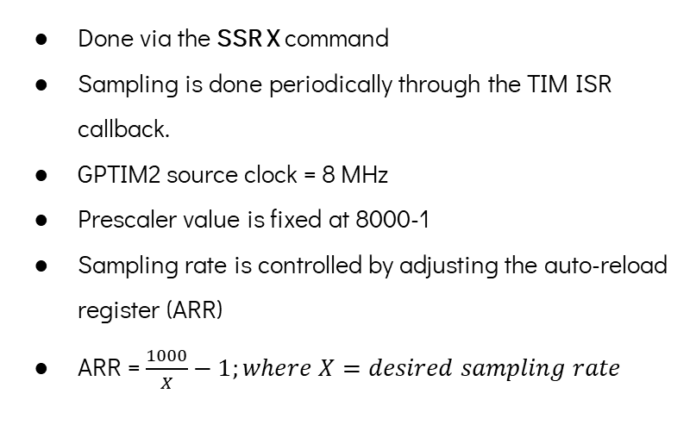
Implementation (cont.)
2. Sampling Rate:
Done via the SSR X command
Sampling is done periodically through the TIM ISR callback.
GPTIM2 source clock = 8 MHz
Prescaler value is fixed at 8000-1
Sampling rate is controlled by adjusting the auto-reload register (ARR)
ARR = $\frac{1000}{X}−1;where X=desired sampling rate$

Slide 13
Implementation (cont.)
3. ECG Data Collection:
Done via the C1MWD command
The 1 minute is marked through the TIM ISR callback.
GPTIM3 source clock = 8 MHz
Prescaler value is fixed at 8000-1
ARR is fixed at 60000-1 to get a minute timer
The C1MWD command triggers the data collection mode and starts TIM2 for sampling

Slide 14
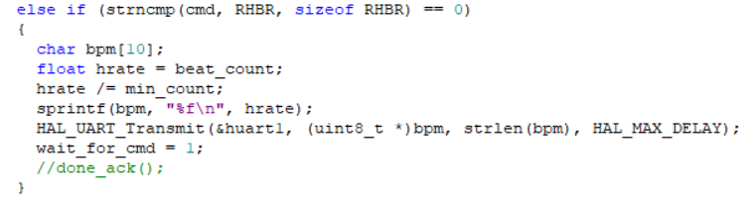

Implementation (cont.)
4. Heart Beat Rate:
Done via the RHBR command.
HBR = $\frac{number of pulses or beats}{number of minutes}$
An activity is considered a beat if it’s no less than 60% of the ADC range in magnitude.

Slide 15
04
Demo Run
Examples of the system in action

Slide 16

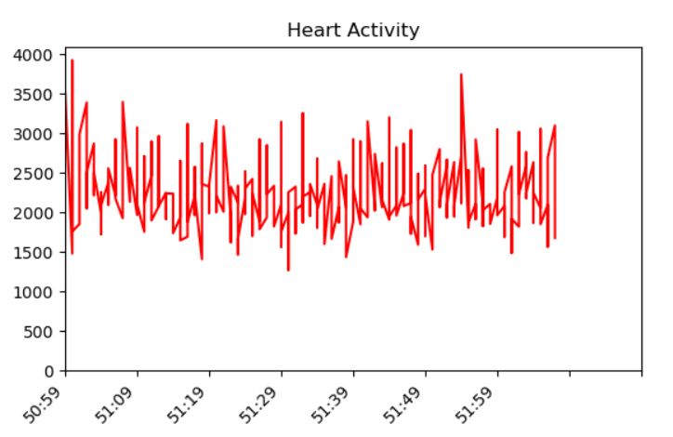

Demo Runs
SSR X:
II. C1MWD
III. RHBR

Slide 17
05
Future Development
What can be improved?

Slide 18
Future Development
The following could be a potential improvement on the presented system:
Using DMA for controlling/triggering ADC conversions instead of interrupts
Utilizing the SDN (shut down) signal of the AD8232 sensor to save power when we’re not sampling its output.
Using a smoother technique for updating graph data in real-time

Slide 19
References
AD8232 Sensor Datasheet
STM32F1 Datasheet
https://learn.sparkfun.com/tutorials/graph-sensor-data-with-python-and-matplotlib/update-a-graph-in-real-time
https://pythonhosted.org/pyserial/index.html

Slide 20
Thank You

